Slide 1
  ooP
  Object Oriented Programing
  “...using OO methods is like
  using a hammer to kill a fly.”
  Gregor Grajzar, 2008

Slide 2
...do danes
.net (VB, C#, C++)
Java
Python
Ruby
PHP 5+
JavaScript
XML (xsd, xslt)
  Prve “aplikacije”:
  PDP-1 in Sketchpad 1963
  C++
  Ada
  Basic
  Fortran
  Pascal
  VisualBasic 6

Slide 3
problem
  - less time
  - less money
- improved service
- better performance
- more informations
- stronger controls
- reduced service
- faster response

Slide 4
Problem vs opportunity
  - abstraction of code
  - reusability
  - scalability (future changes)
  - error handling
  - arch. designing & prototyping
  - security

Slide 5
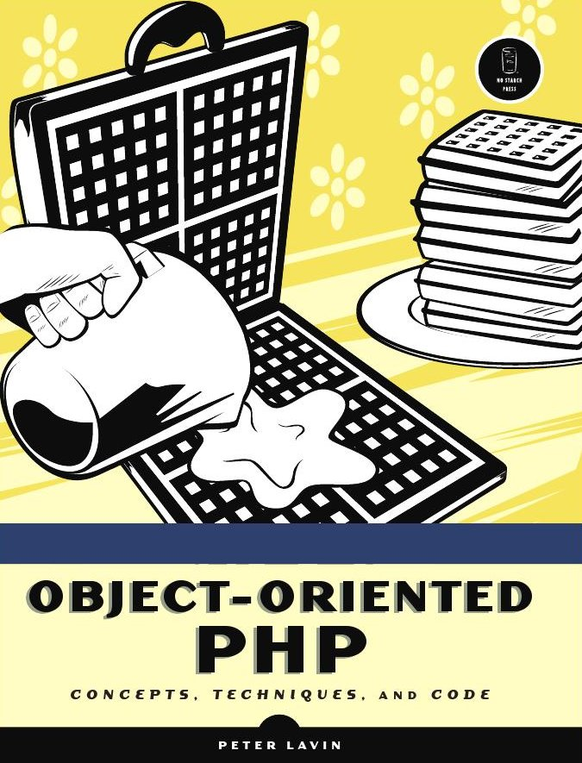
Where to start?

Slide 6
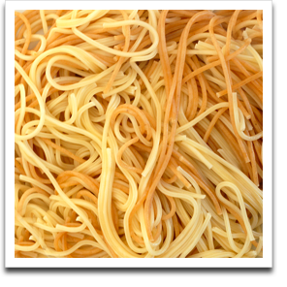
Problem solved:
  class cook_book{
  public function make_spagetti(){
  }
  }

Slide 7
New terminology
  Classes, attributes, methods, delegates, visibility, constructors, destructors, namespaces
  Programing by contract, scope, reusability, encapsulation, instance,polymorphism, inheritance, relationship, dependendency, association, aggregation, delegates,...
  Paamayim Nekudotayim

Slide 8
Magic begins
  Patterns:
  Behavioral patterns
  Structural patterns
  Concurrency paterns

Slide 9
A Grip of Patterns
Phases:
  1. Designing
  2. Mining
  3. Polishing
  4. Reuse
Expirience!

Slide 10
patterns:
  - singleton
  - factory
  - abstract factory
  - adaptor
  - template pattern
  - observer
  - chain-of-command
- iterator
- strategy
-decorator
- delegate
- state
- mediator
- state
- visitor

Slide 11
Database design
master_record
master_id
date
valid_version
segment
segment_id
master_id
content
version
...
header_record
header_id
master_id
date
title
abstract
version
...

Slide 12
Problem solving
  - Bigger picture
  - Limitations of PHP: multiple inheritance
  - Traps: Use of static classes
  - Database design & limitations
  - Alternatives
  - Criticism
  - Legacy

Slide 13
Bigger picture
  Extended knowledge
  Fundamental research
  Perception
  Out the box rule
  80:20 rule

Slide 14
literatura
  Web:
  http://phpdeveloper.org
  http://en.wikipedia.org/wiki/Object-oriented_programming
  http://www.php.net/manual/en/language.oop5.php
  http://www.ibm.com/developerworks/views/opensource/libraryview.jsp?search_by=php
  PHP books:
  Pro PHP Patterns Frameworks Testing and More
  PHP 5 Power Programing (Andi Sting Seather Bakken, Derick Rethans)
  Advanced PHP Programing (George Schlossnagle)
  Classic Books:
  Design Patterns (gang of four)
  Patterns of Enterprise Aplication Architecture (Martin Flower)
  Pattern-Oriented Analysis and Design (Sherif M. Yacoub, Hany H. Ammar)

